Slide 1

CAPSTONE PROJECT (SHOPFOR HOME)
PRESENTED BY:
A. Shanthi Priya
A. Niharika Reddy
Atishay Jain
Mrudul Mahendra Kadam
kotni.Mounika
JAVA &AWS C3 GROUP-13
MENTOR:MR.NEERAJ KUMAR KHERIA
Notes:
© Copyright PresentationGO.com – The free PowerPoint and Google Slides template library

Slide 2
INTRODUCTION
Problem Statement: ShopForHome is a popular Store in the market for shopping the home décor stuff . Due to Covid 19 all the offline shopping stopped. So, the store wants to move to the cloud platforms and wants their own web application
There are 2 users on the application: -
1. User
2. Admin
Notes:
© Copyright PresentationGO.com – The free PowerPoint and Google Slides template library

Slide 3

TECHNOLOGIES USED:
Angular
Spring Boot
SQL
Softwares Used:
Eclipse IDE
Visual Studio code
MySQL
Notes:
© Copyright PresentationGO.com – The free PowerPoint and Google Slides template library

Slide 4

Sprint I Objectives
1.Create git repository
2.Create database schema (all tables along with their relationships)
3.Create entities in Spring
4.Create Microservice based structure
5.CRUD on User and Products
6.Create an eCommerce Template in Angular (Static only) to hold images and products lists
7.Develop Search Functionality in Angular
8.Bulk upload implementation

Slide 5

Sprint II Objectives
1.Cart option
2.Stock and Sales reports
3.Create Data Transfer objects
4.Create repository
5Create Service layer logic
6.Create Controller to direct rest api
7.Create Discount Microservice

Slide 6

GIT REPOSITRY
https://github.com/MrudulKadam/ShopForHome.git

Slide 7
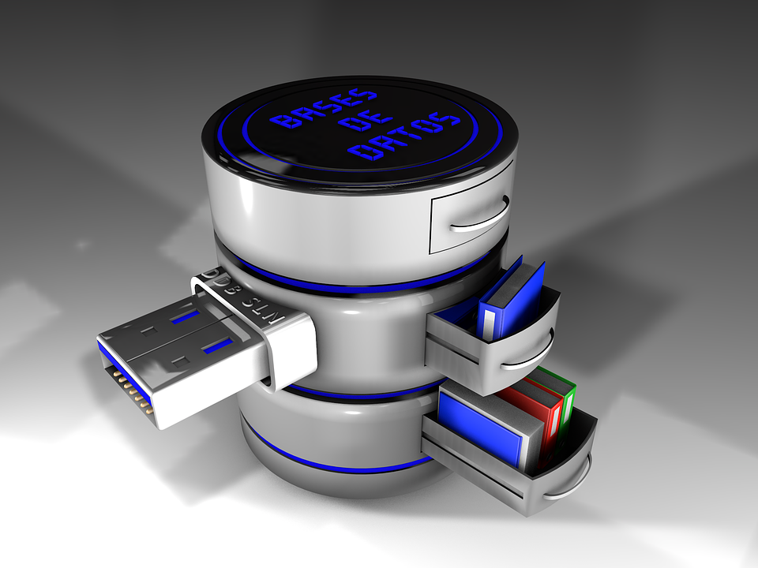
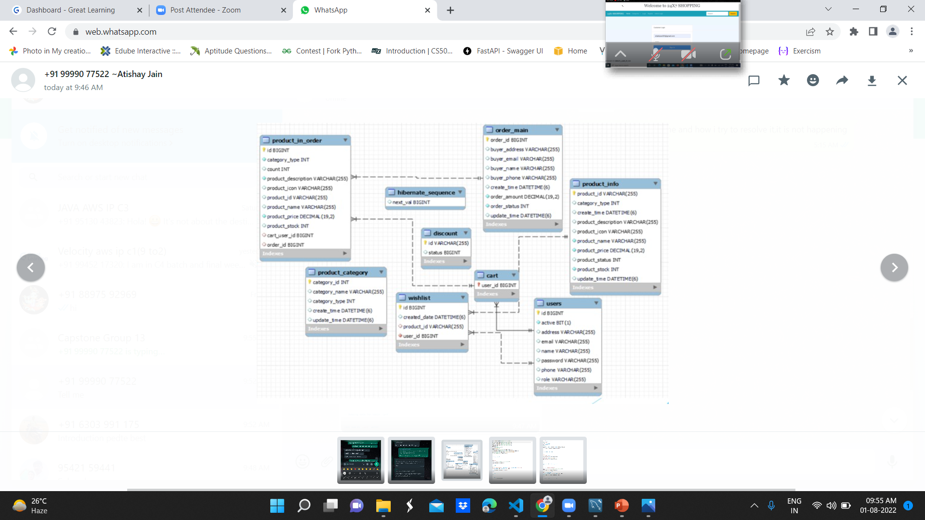
DATABASE SCHEMA
Notes:
© Copyright PresentationGO.com – The free PowerPoint and Google Slides template library

Slide 8

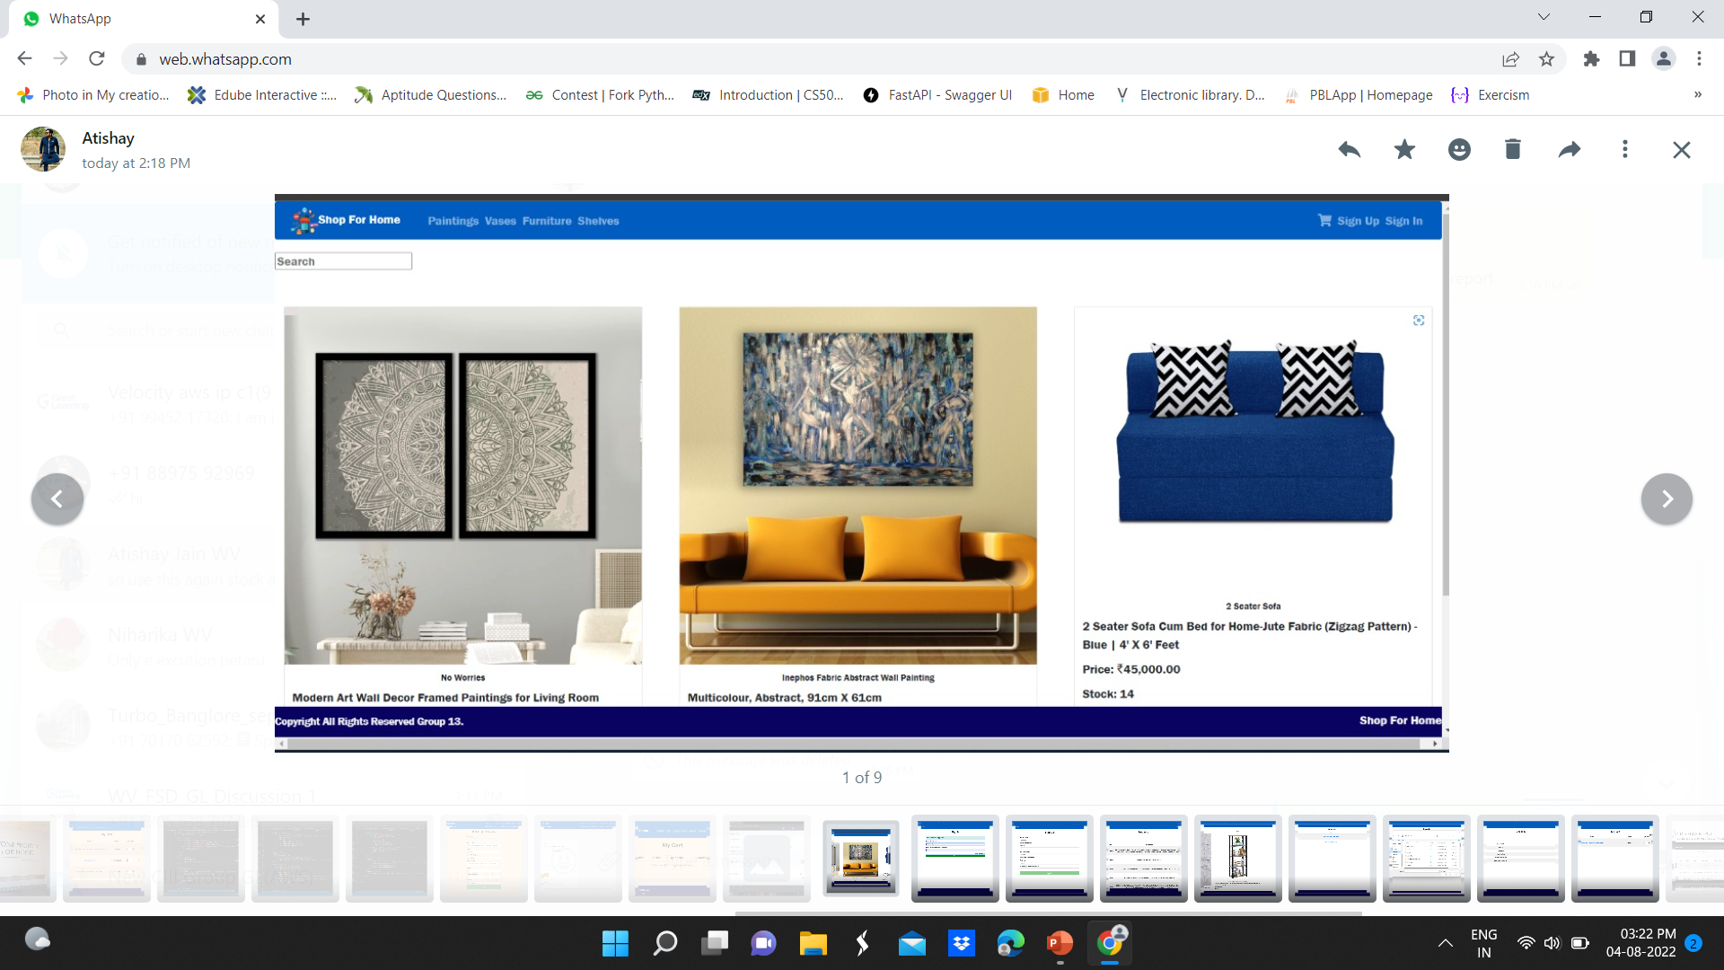
ECOMMERCE TEMPLATE(HOME PAGE)
Notes:
© Copyright PresentationGO.com – The free PowerPoint and Google Slides template library

Slide 9

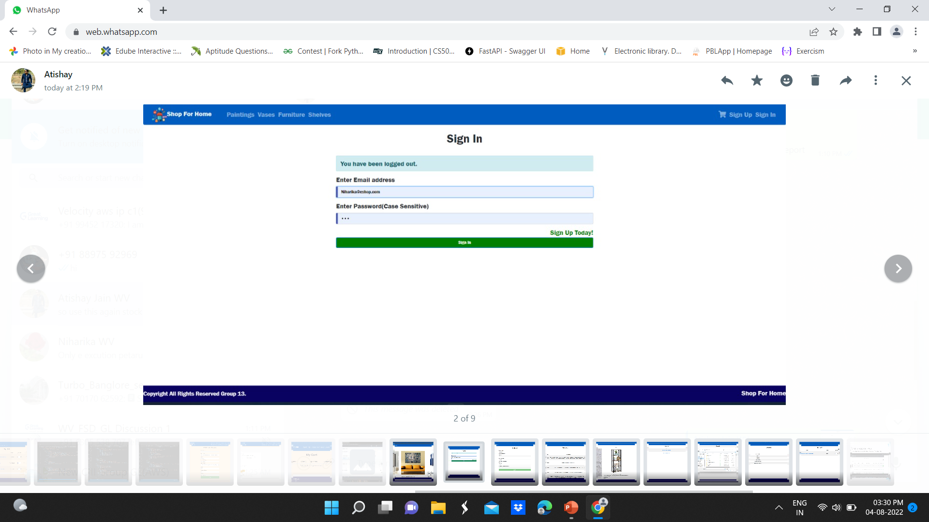
SIGN IN

Slide 10

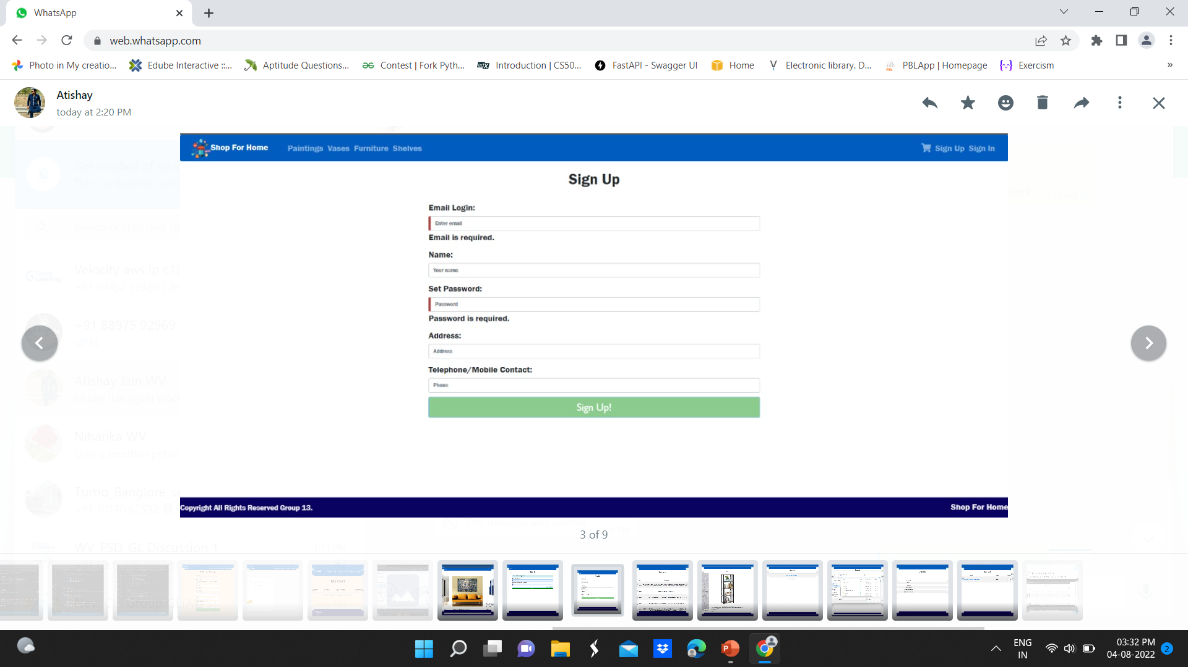
SIGN UP

Slide 11

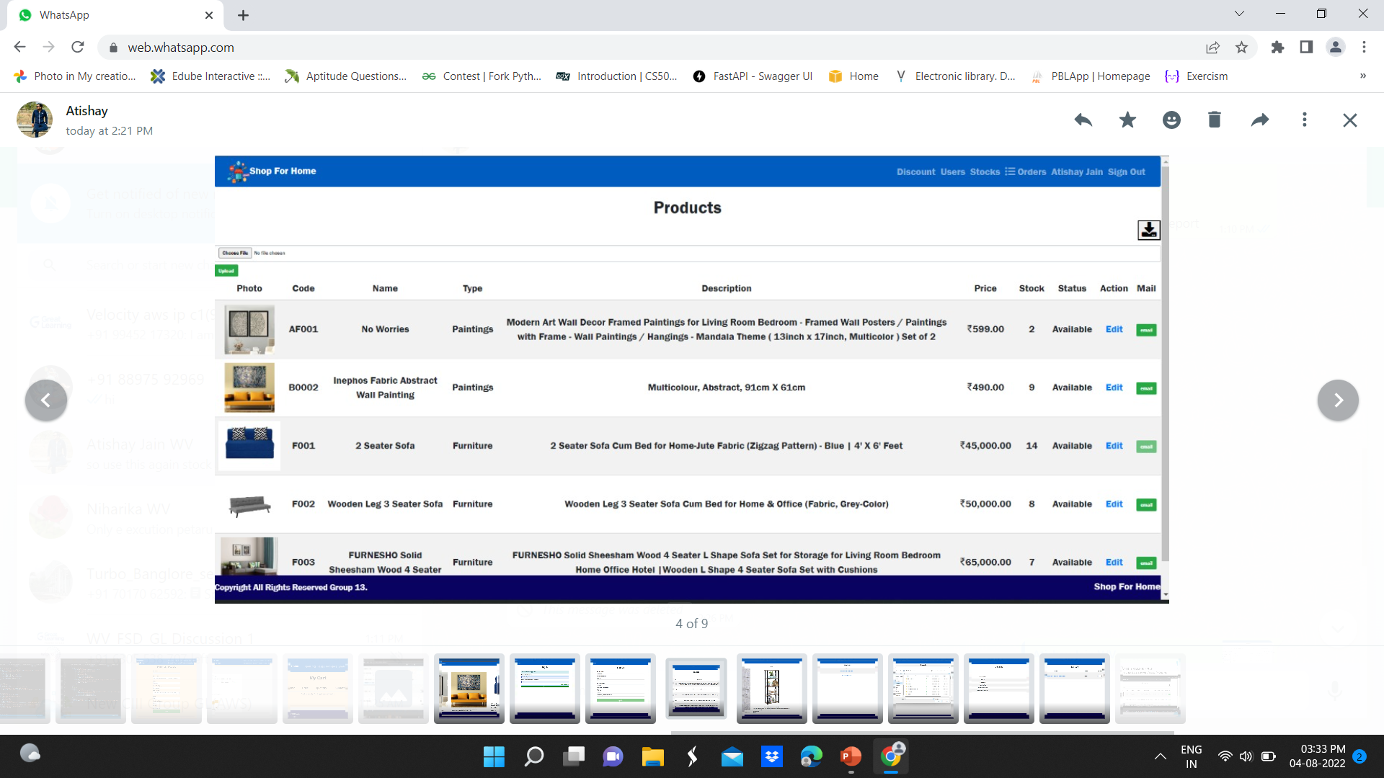
PRODUCT LIST

Slide 12

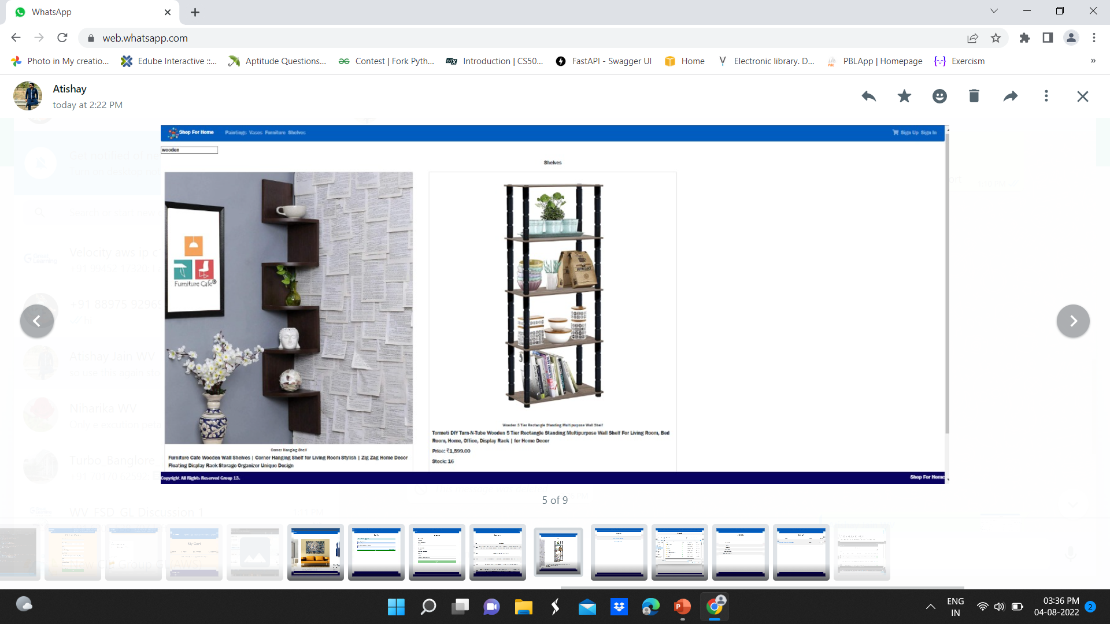
SEARCH

Slide 13

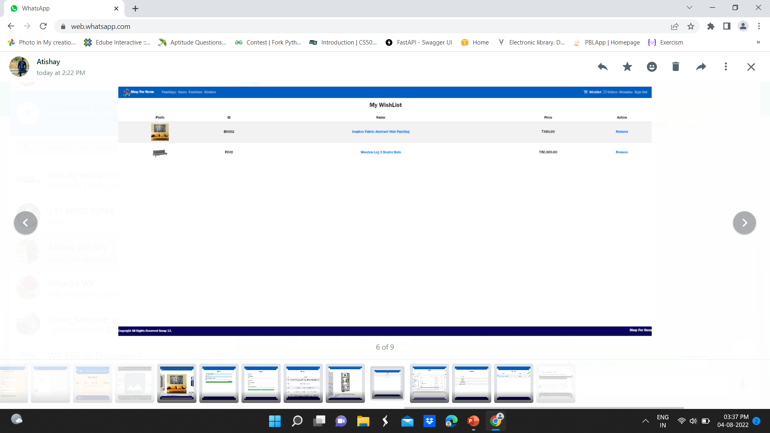
WISHLIST

Slide 14

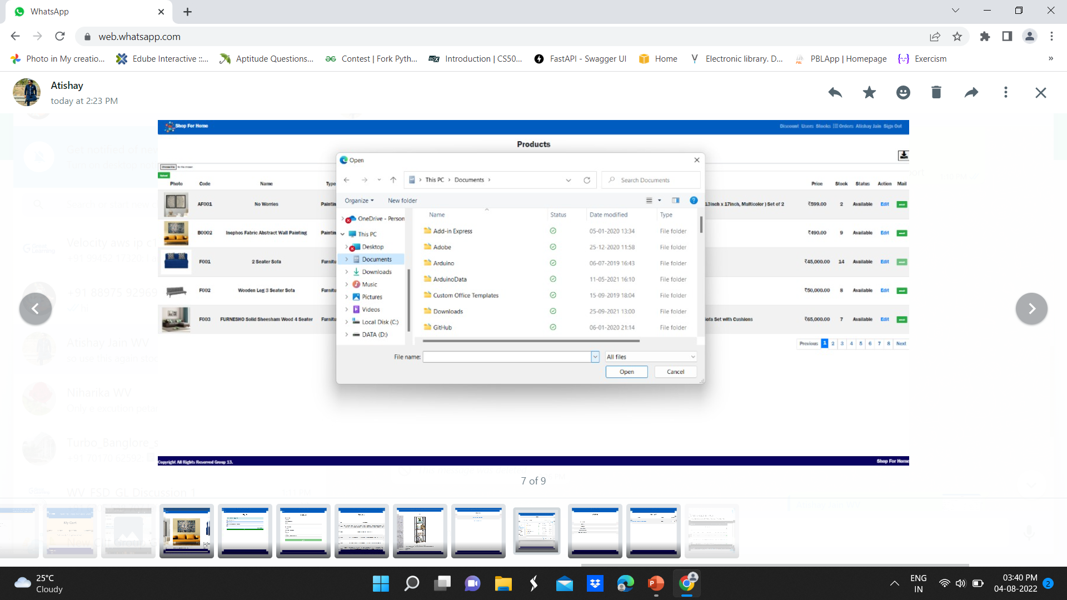
BULK UPLOAD

Slide 15

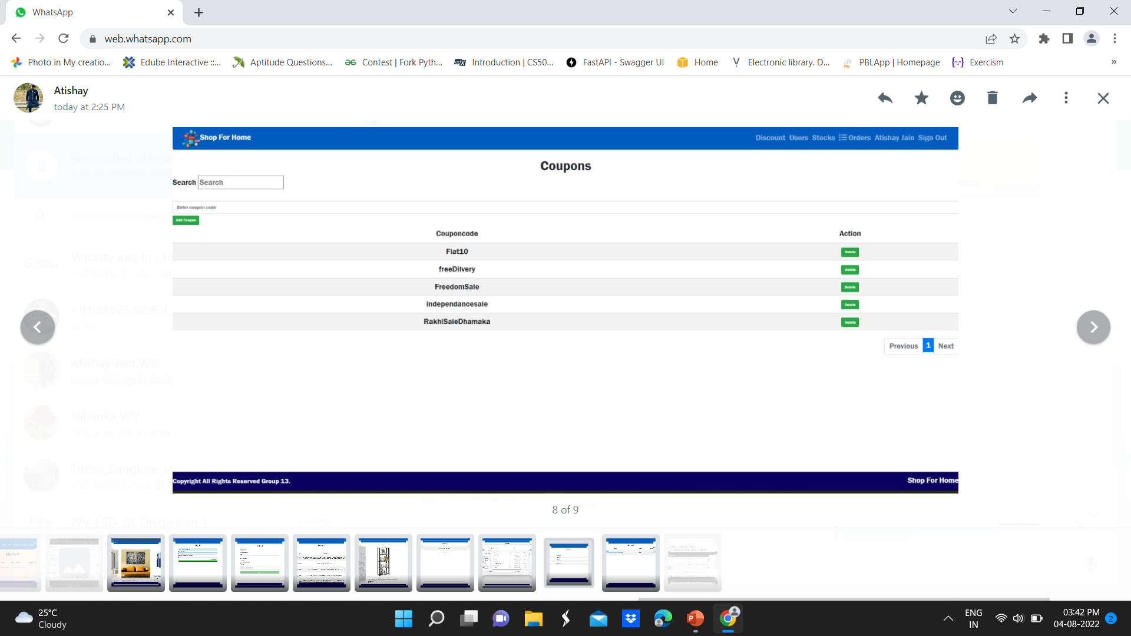
DISCOUNT COUPONS

Slide 16

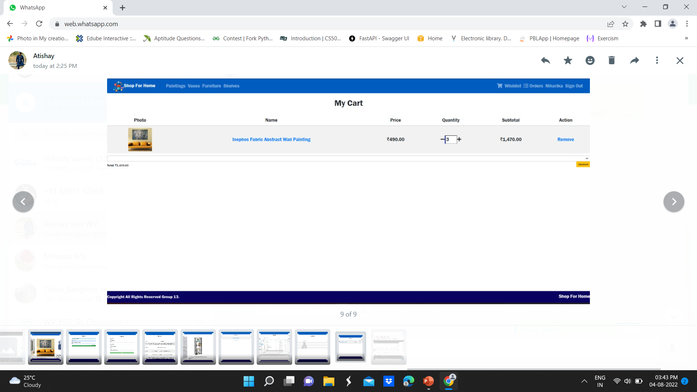
CART OPTION

Slide 17

STOCK AND SALES REPORT

Slide 18

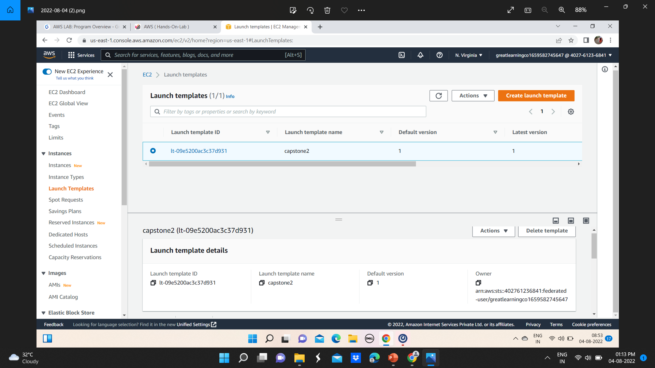
DEPLOYING EC2 INSTANCES Launch Templates

Slide 19

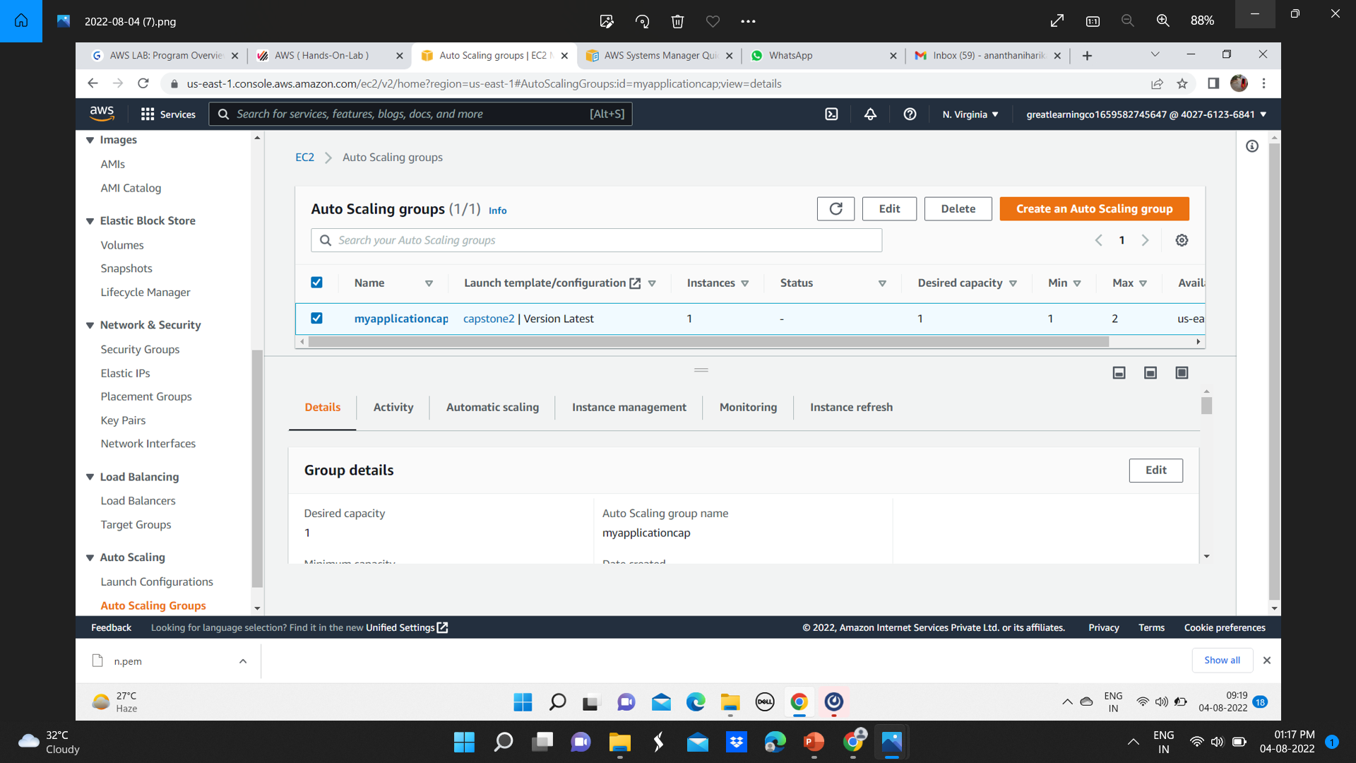
AUTO SCALLING GROUP

Slide 20

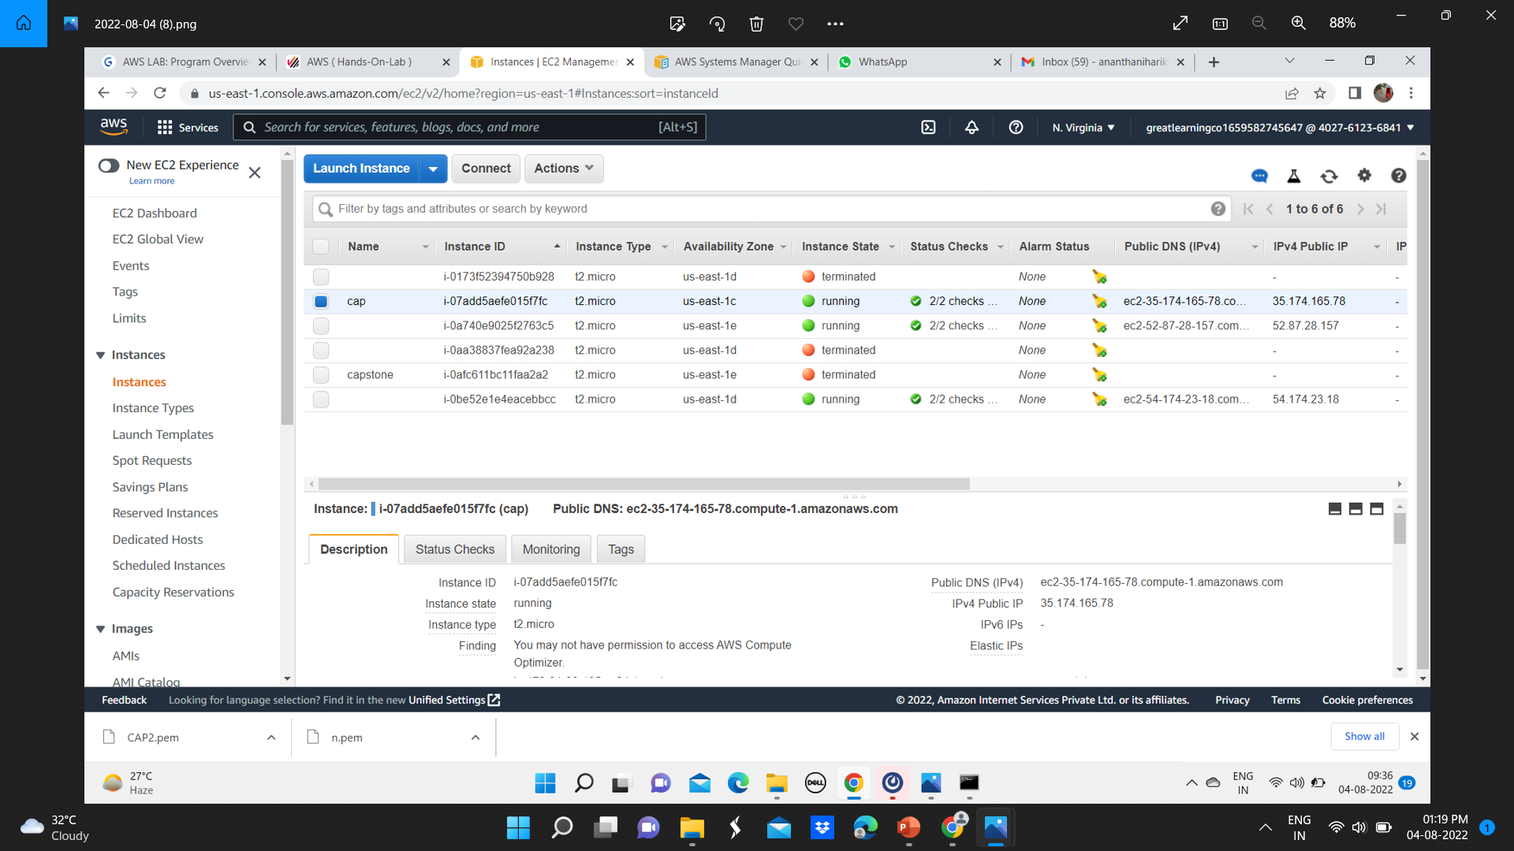
EC2 INSTANCES

Slide 21

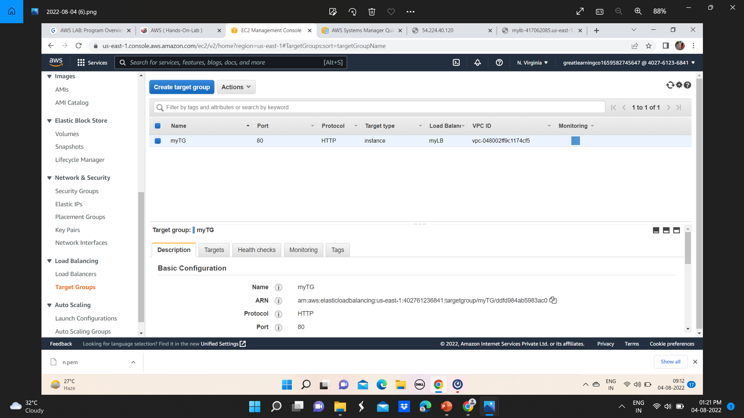
TARGET GROUP

Slide 22
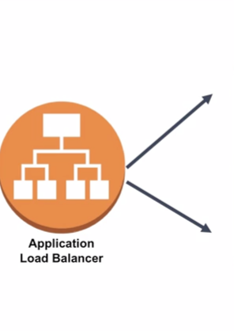
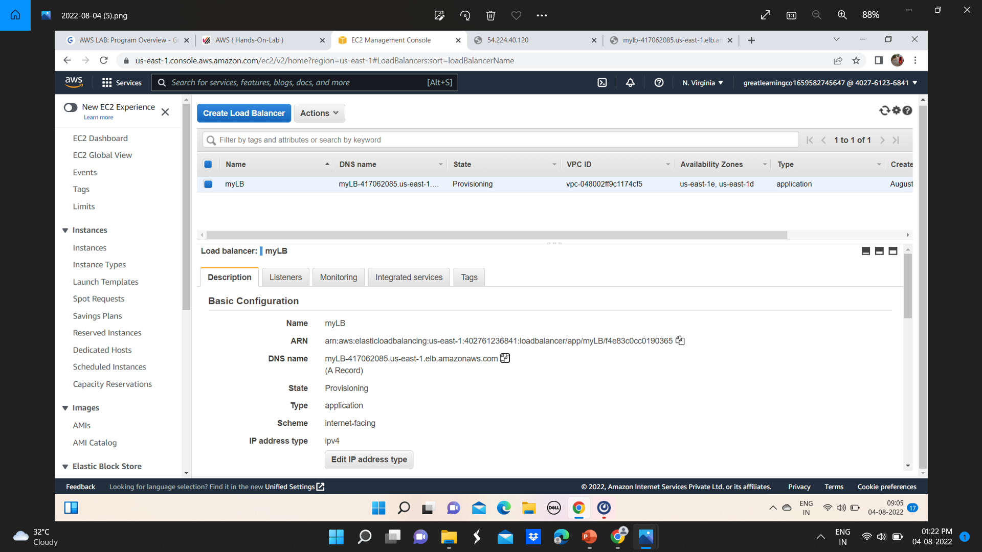
LOAD BALANCHER

Slide 23

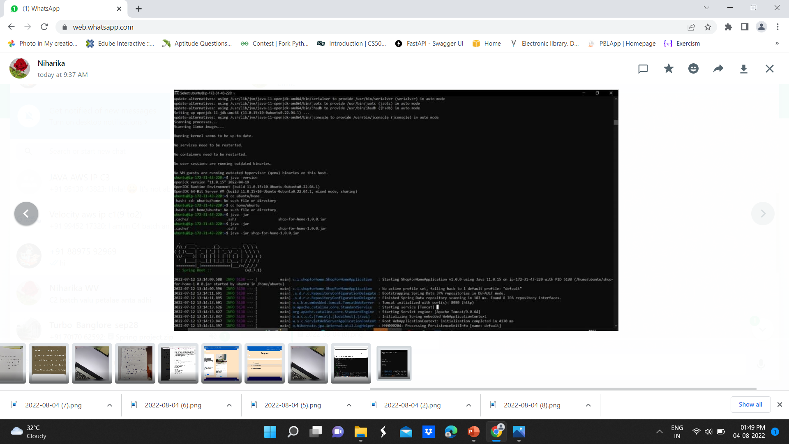
Starting the Application shop-for-home-1.0.0.jar

Slide 24

Thank You!
Thank you for this opportunity.
A big thanks to Neeraj for his excellent mentorship.
Notes:
© Copyright PresentationGO.com – The free PowerPoint and Google Slides template library

